Slide 1
Analysis of Head Start Accessibility
Group : Dataminers
Member: Zizheng (Sean) Zhang
Yinming (Randall) Gao
Notes:
Good afternoon everyone! Today, we, the Dataminers, are excited to present our analysis of Head Start accessibility. Let me introduce our team members: Zizheng (Sean) Zhang and Yinming (Randall) Gao.

Slide 2
Agenda
Background
Technologies In-use
Major Findings
Major Insights
One More Thing
Notes:
Let's quickly walk through our agenda for today. We will cover the background of Head Start, the technologies we utilized, our major findings and insights, and a special feature we've developed.

Slide 3
Background
Established in 1965, Head Start promotes school readiness for children in low-income families by offering educational, nutritional, health, social, and other services. The program is rooted in urban, suburban, and rural communities throughout the nation.
Notes:
Established in 1965, Head Start helps low-income kids get ready for school. It offers a range of services from education to health, ensuring holistic development.

Slide 4
Background (cont'd)
Service Mismatch: Only 30% of 3-to-5-year-olds and 9% of infants in poverty were served by Head Start.
COVID-19 Effect: A drop of 287,000 children in Head Start attendance in 2020-2021 compared to 2018-2019.
Funding Discrepancies: States with more child poverty receive less funding per child for Head Start.
Notes:
Despite its noble intent, there are challenges. Only a fraction of eligible children are served by Head Start, with the COVID-19 pandemic causing a further drop in attendance. Additionally, funding discrepancies exist across states.

Slide 5
Technologies In-use
Python: for data extraction, data analysis, statistical modeling, data pipeline automation, and web API development
HTML, CSS, Javascript: for web development
Tableau: for data visualization.
PowerPoint: for the presentation of insights.
Notes:
To conduct our analysis, we leveraged various technologies: Python for data handling and analysis, web technologies for development, Tableau for visualization, and of course, PowerPoint to share our findings with you.

Slide 6
Major Findings
Notes:
Let's dive deep into our primary discoveries.

Slide 7
Metrics
Center Coverage Rate (County level)
Children per Center
Enrollment Rate
Fund per Child
Notes:
These are the key metrics we've focused on to assess the program's accessibility and efficiency.
And we will interpret them one by one later.

Slide 8
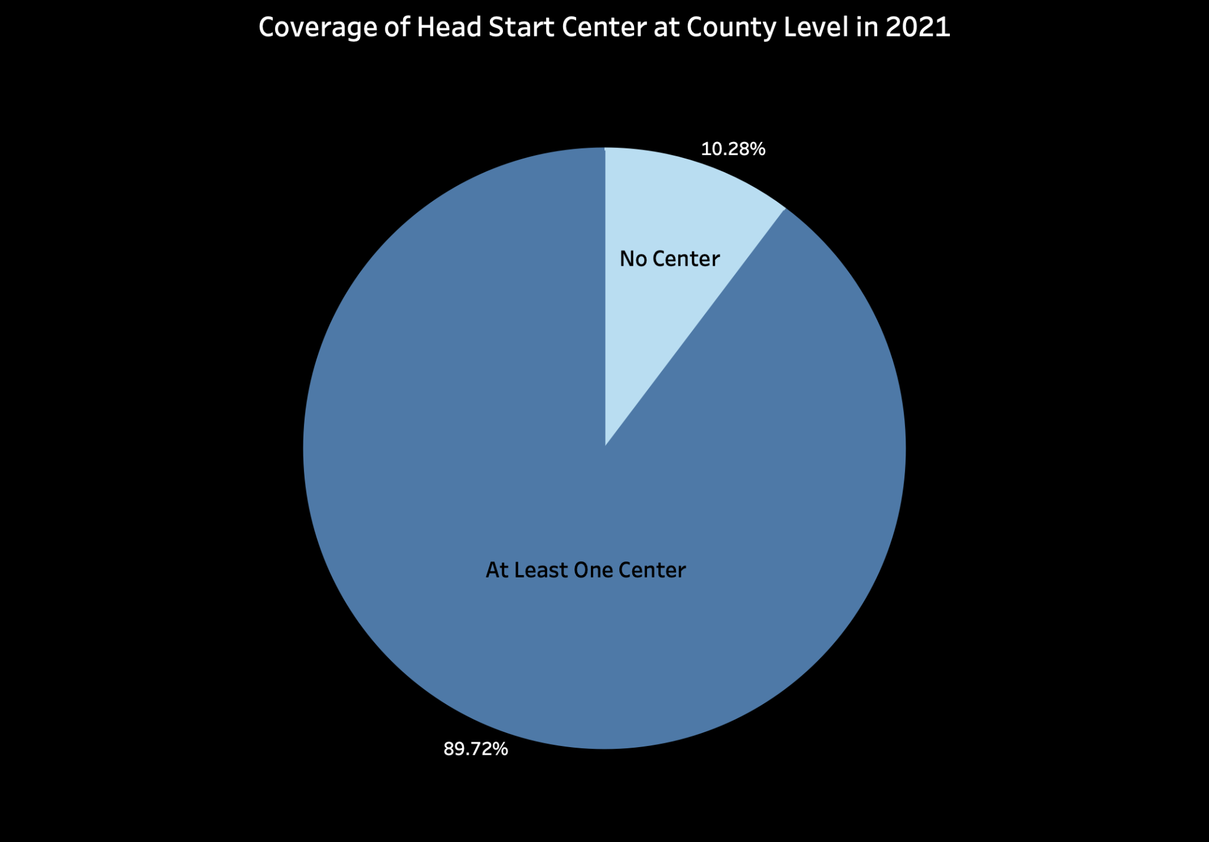
No Center: 315
At Least One Center: 2,748
Coverage Rate
= # of county with center / total # of county
Notes:
This is a pie chart showing that the counties with at least one center account for around 90%. However, there are still 315 counties without even one center, which underscores an accessibility issue.

Slide 9
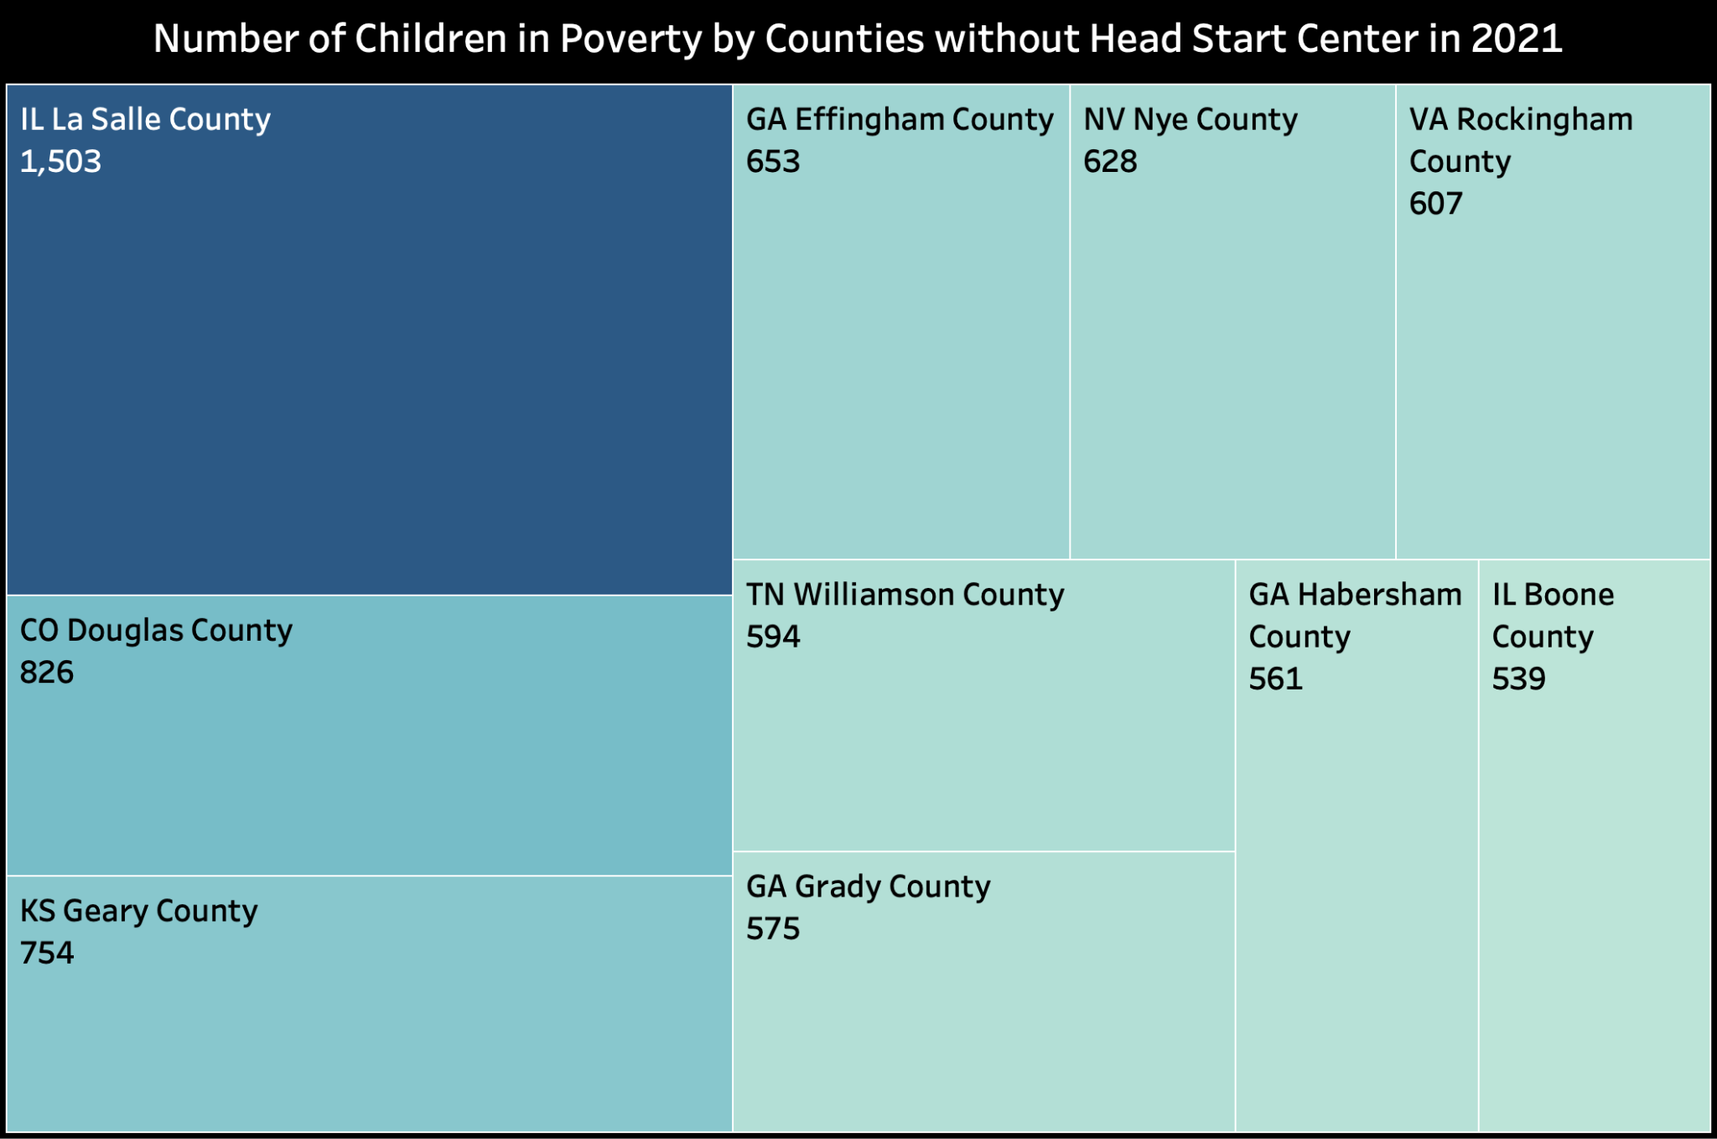
10 Counties without Head Start Center
Notes:
Here, we highlight ten counties that are particularly underserved and the number of children from low-income families in that county.

Slide 10
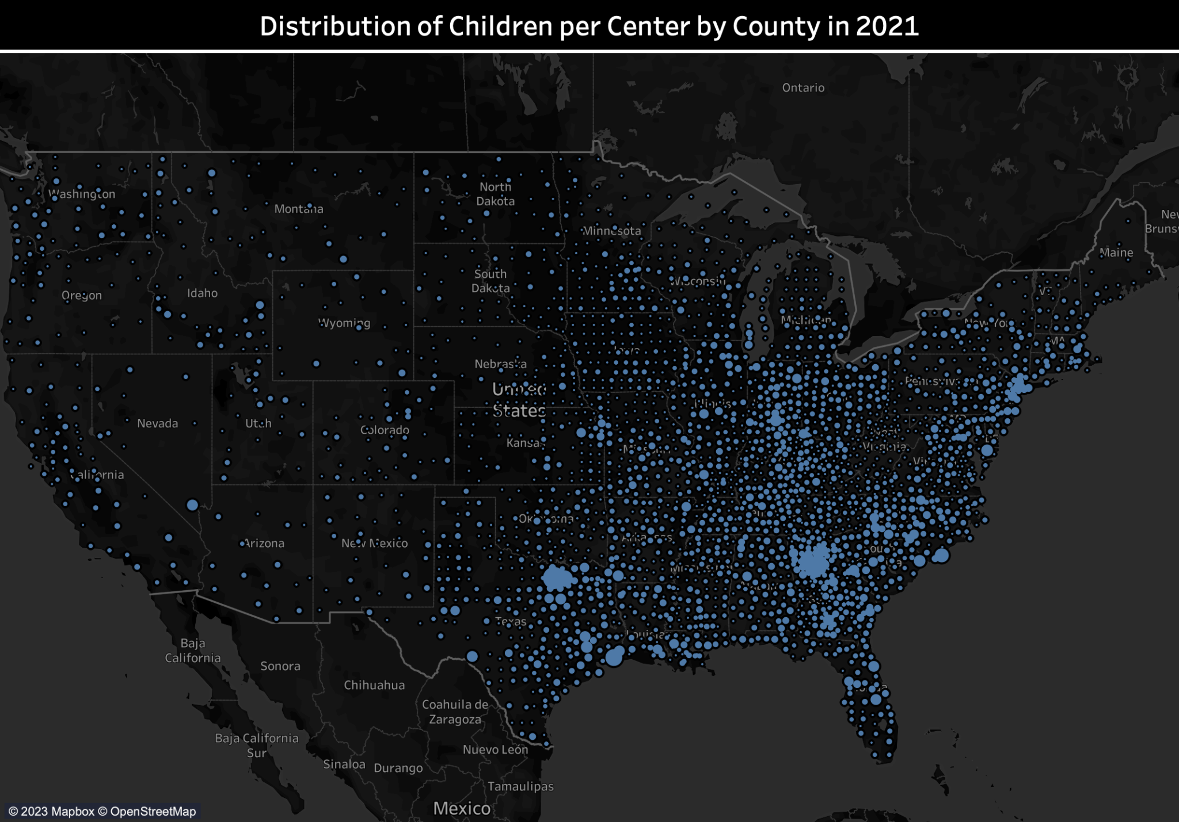
- Children/Center
- East & West
Notes:
Owing to a lack of poverty data at county level, we used the estimated number of impoverished children to divide the number of head start centers at a county, thereby calculating the cpc metric, which helps measure the accessibility of head start program at a county. The size of the spots on the map is proportional to the calculated value of cpc. The larger the size, the higher the value of cpc at the region.

Slide 11
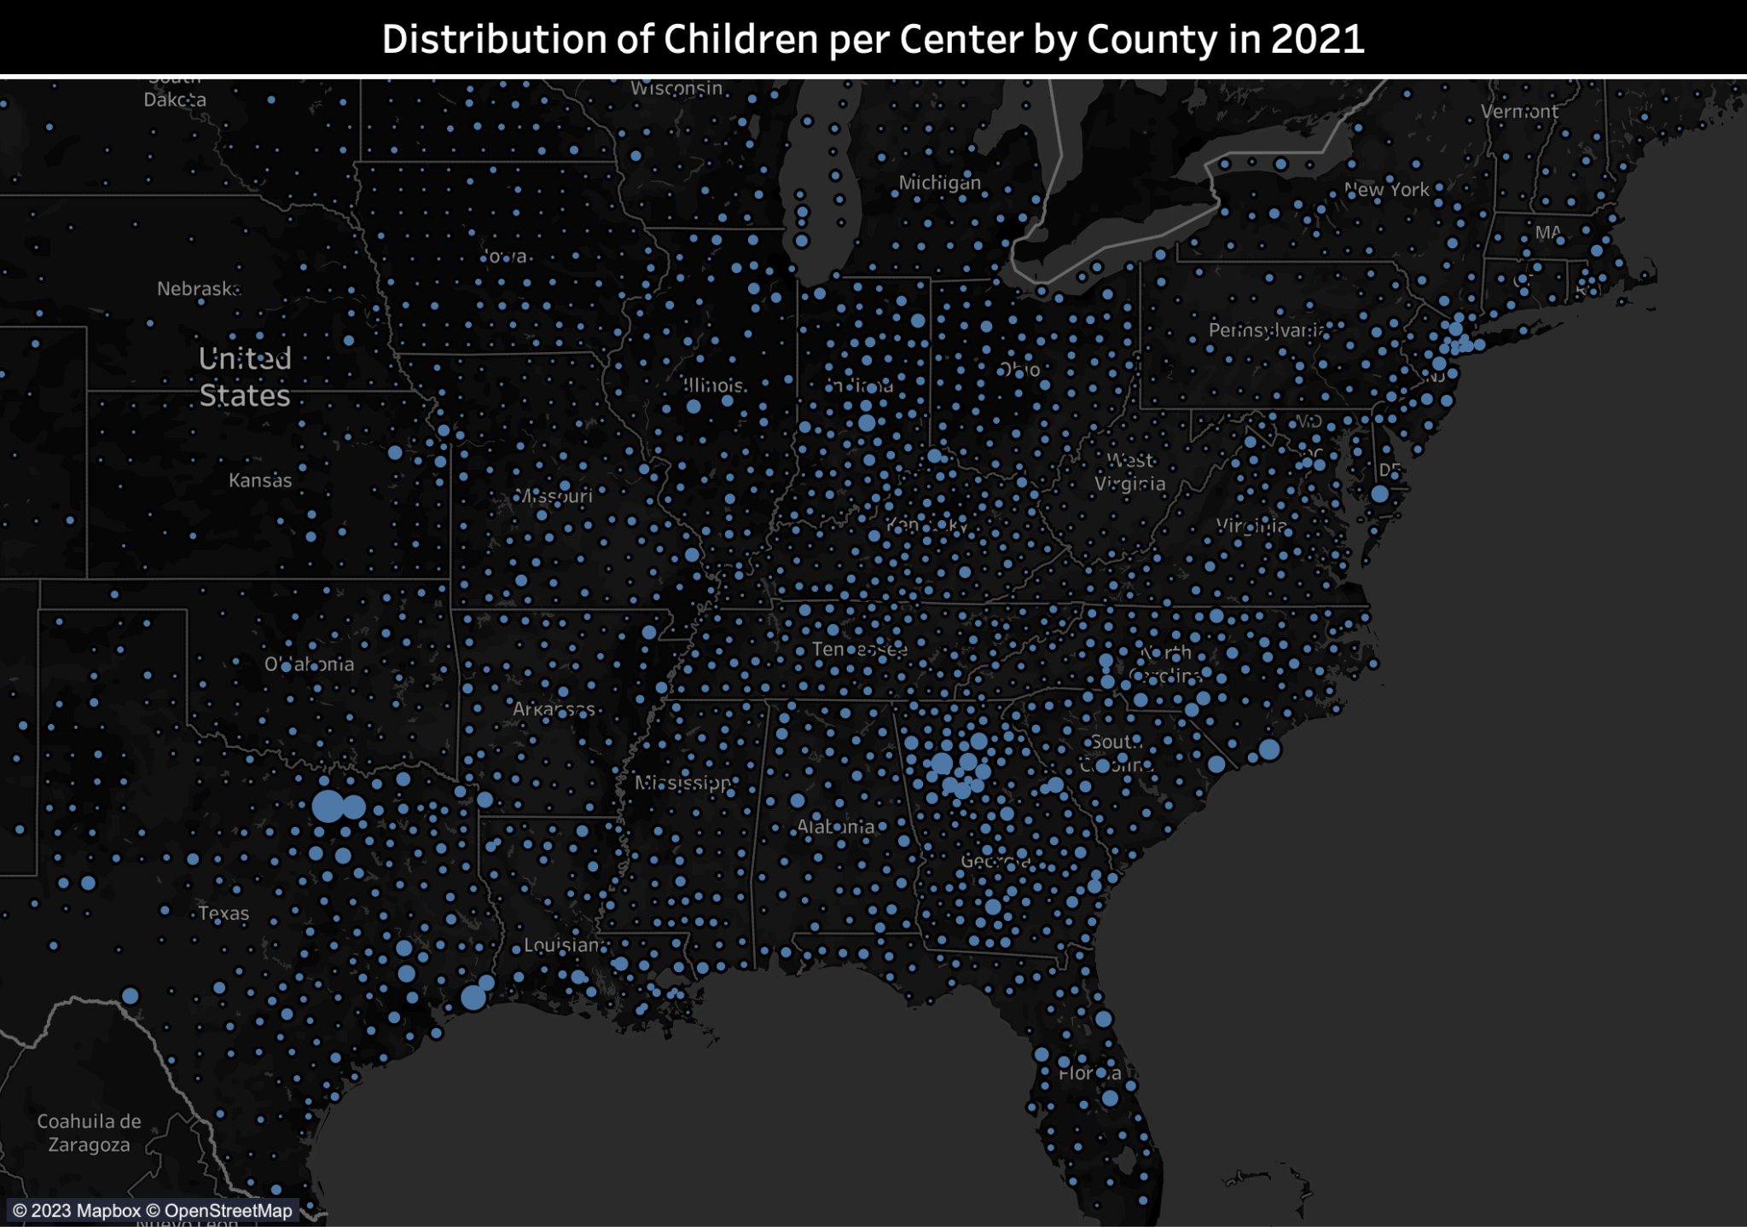
Texas & Georgia

Slide 12
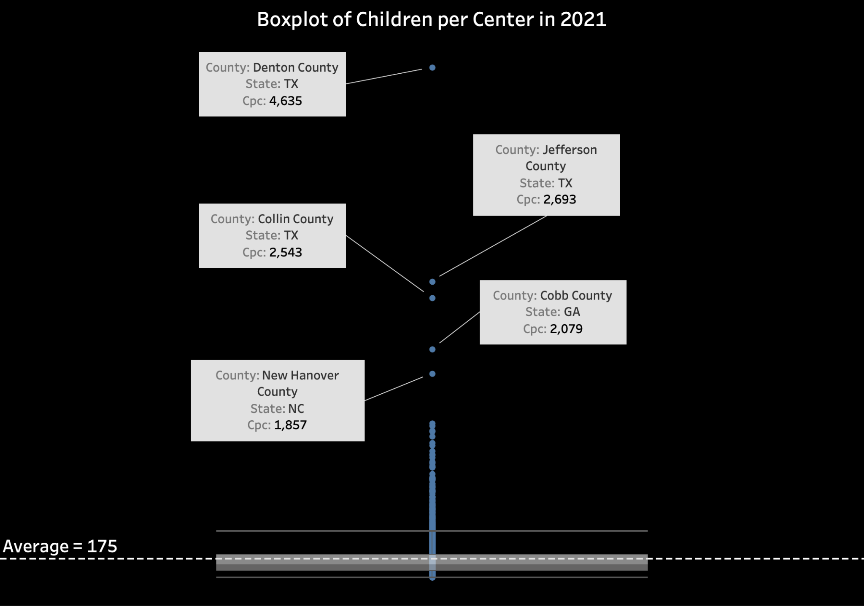
Cpc (Children per Center)
= # of children in poverty / # of center in one county
Notes:
The cpc level across counties are similar, yet there are few abnormalities, such as Denton county and Jefferson county at TX, where abnormally high values of cpc are observed, indicating potential low accessibility to head start program. Policy makers may need to pay more attention to these highlighted areas.

Slide 13
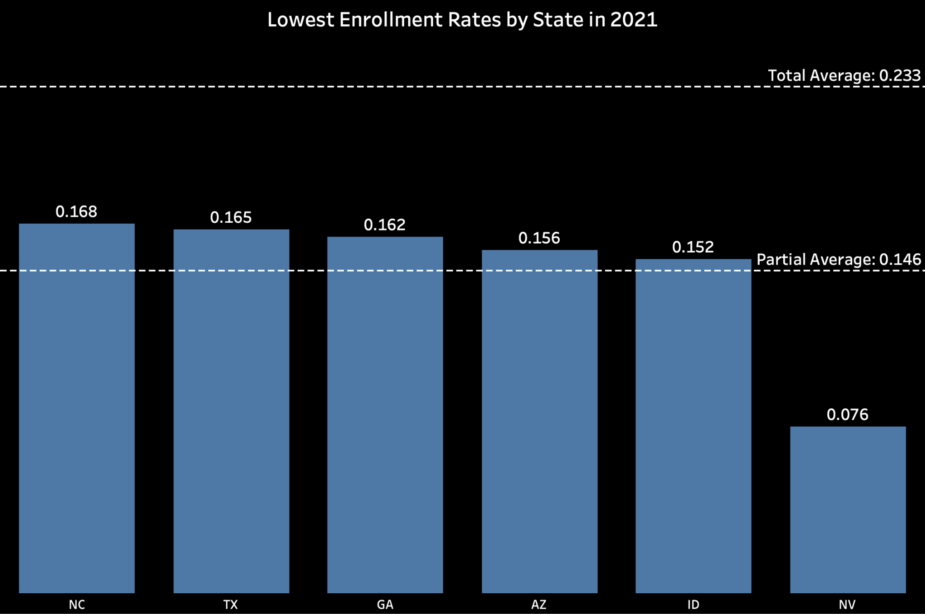
6 States with the Lowest Enrollment Rates
Enrollment Rate
= number of enrollments / estimated number of children in poverty
Notes:
Definition of enrollment rate
Usage: to measure if the head start program is well utilized in an area
48 contiguous states were analyzed
Top six with lowest enrollment rate are listed here
Low enrollment rate implies three potential issues:
Too few public exposure so that families in poverty aren’t aware of head start
There are other local policies that have taken effect such that local families dont need head start
Head start program’s quality is poor at those areas.

Slide 14
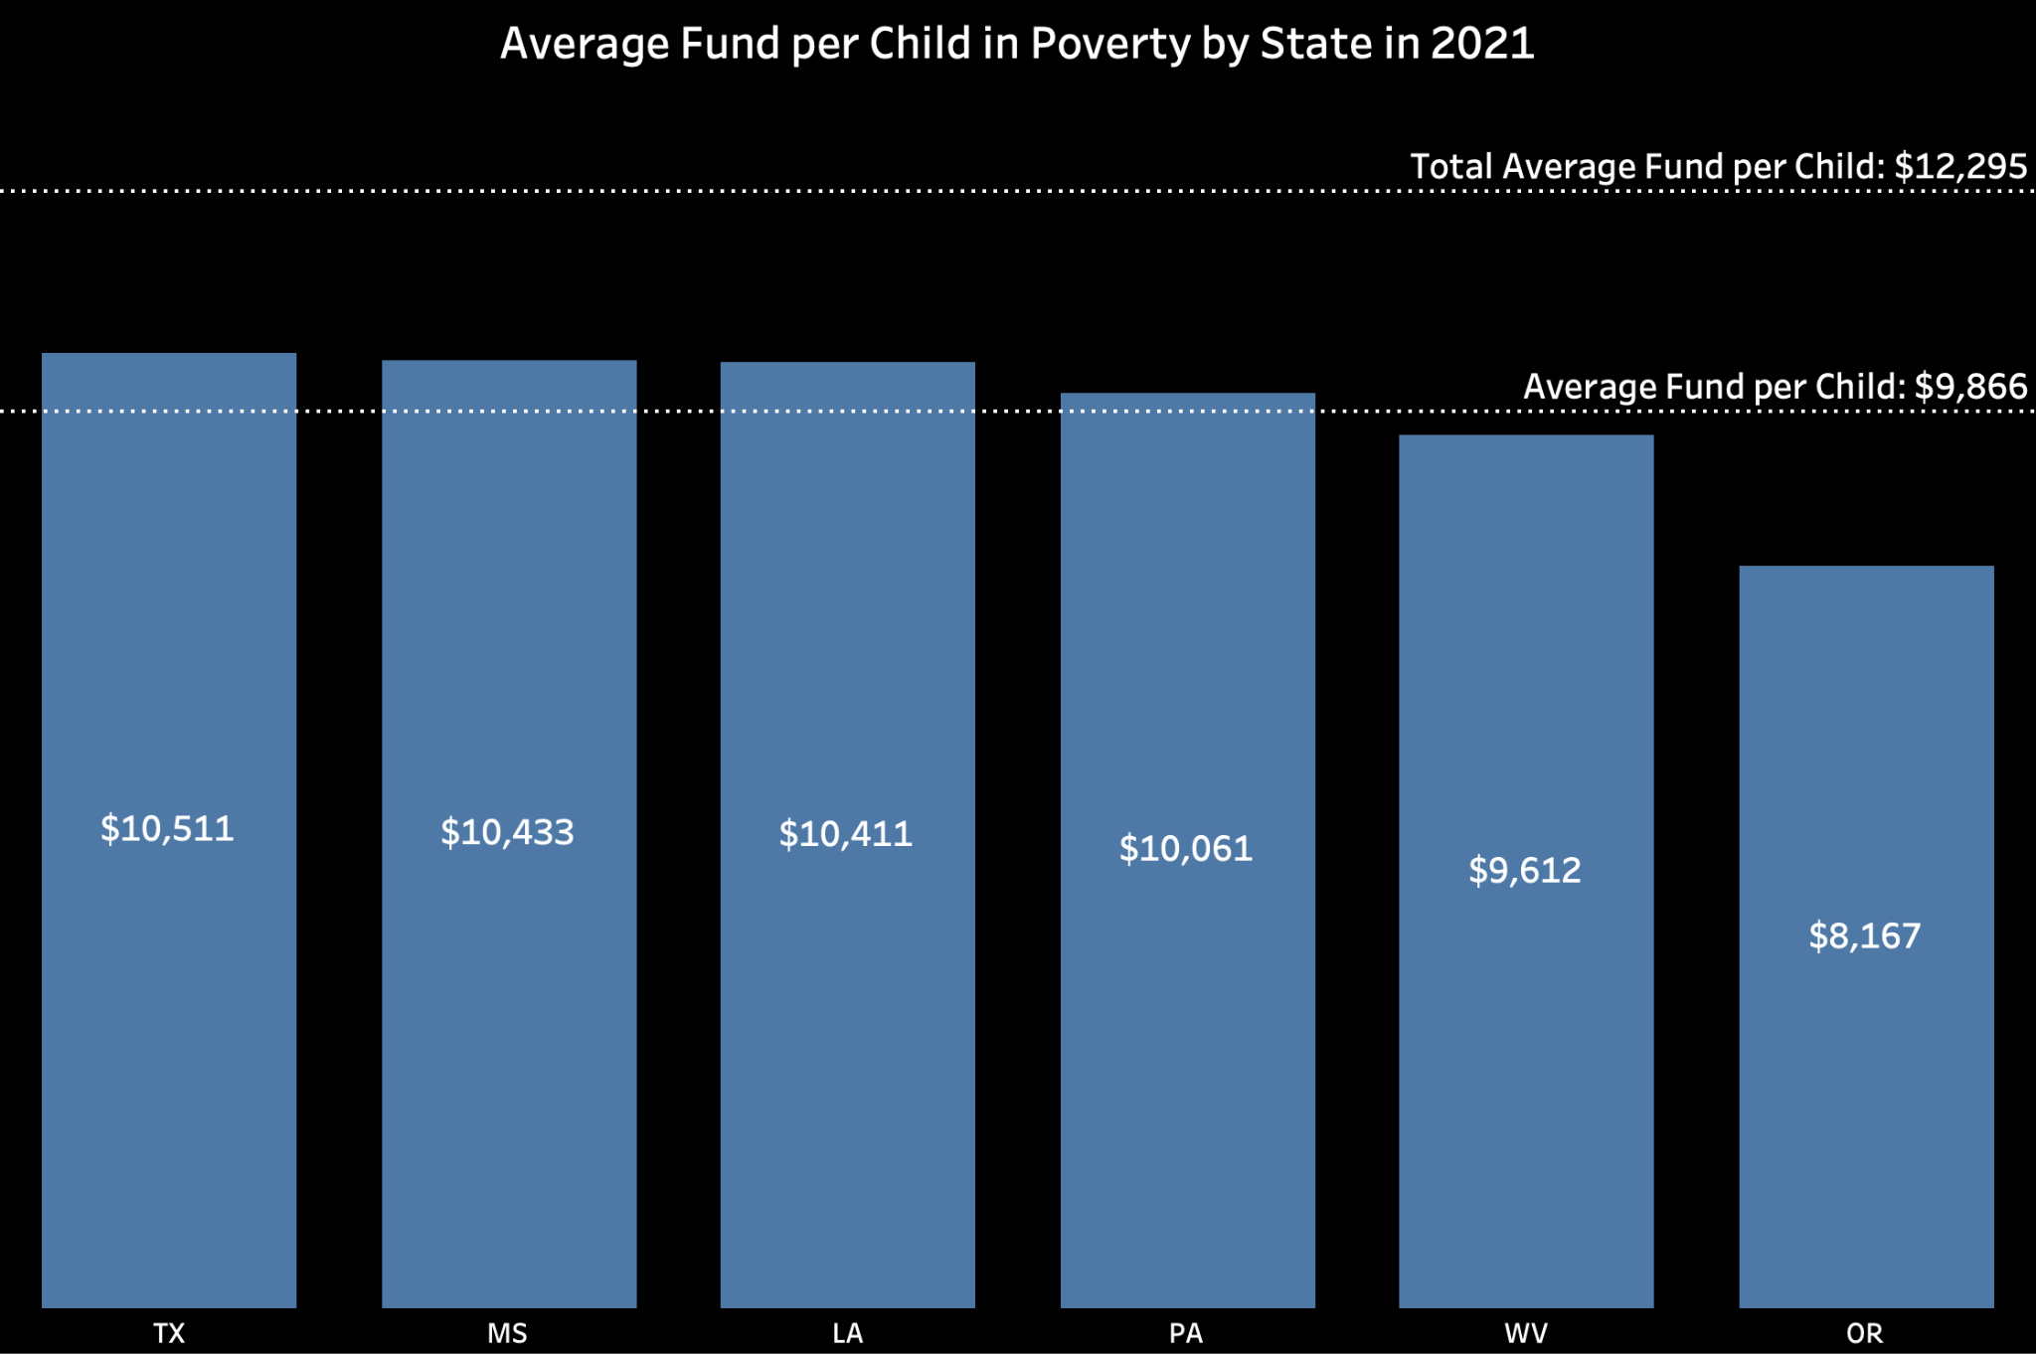
6 States with the Lowest Average Fund per Child
Fund/Enrolled Children
Notes:
Definition of fund per child: annual federal funding received divided by the number of enrollments.
Usage: measure and compare the fiscal support given to each region.

Slide 15
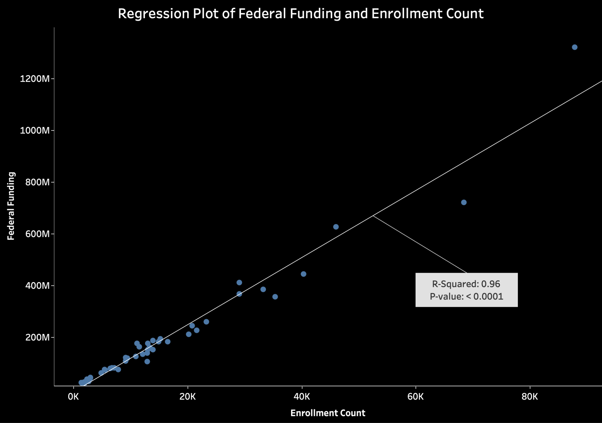
Notes:
Econometric study: the relationship between funding and enrollment count
Conclusion: funding policy is reasonable in that it is roughly proportional to enrollment

Slide 16
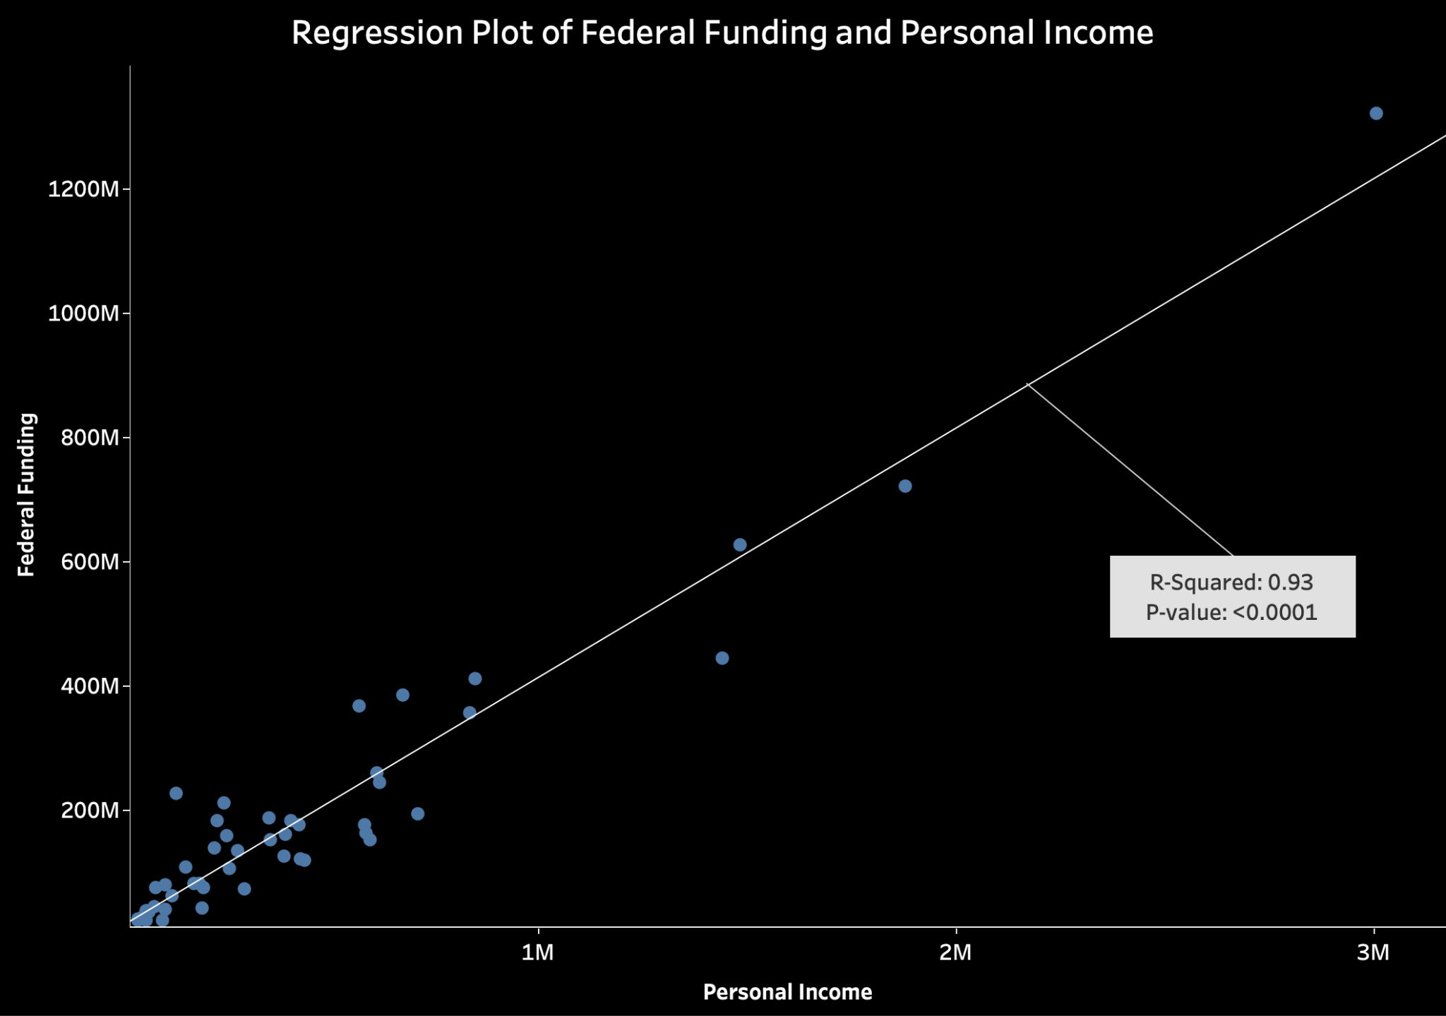
Notes:
Econometric study: the relationship between funding and personal income
Conclusion: funding policy is reasonable in that it is roughly proportional to local economy standard.

Slide 17
Major Insights
Notes:
dsa

Slide 18
Major Insights - Public Policy
Certain counties in TX and GA may be underserved by Head Start. Policy makers may need to find more Head Start participants in those areas so as to facilitate the accessibility of Head Start.
Nevada, Idaho, Arizona, Georgia, and Texas are the states with the lowest estimated enrollment rate, meaning that the communities in these five states are likely underserved. Policy makers may need to increase public exposure to Head Start, especially to low-income families, so that low-income families are aware of Head Start and begin enrolling in Head Start.
The funding policy of Head Start is well adapted to local economic and demographic situation.

Slide 19
Major Insights - Technology Innovation
In many cases, plain data are informative, but not ready to use. It is through an analytics pipeline where the raw data endures sequential processing and transformation that the underlying information and insights in the raw data become visible.
Automated analytics pipeline can remove the recurrent and repeated part of data analytics. For data of time series nature such as annually updated data, with well defined metrics and robust external data sources, the extraction, transformation, and loading of the data can be an automated process.
Notes:
In many cases, plain data are informative, but not ready to use. It is through an analytics pipeline where the raw data endures sequential processing and transformation that the underlying information and insights in the raw data become visible.
Automated analytics pipeline can remove the recurrent and repeated part of data analytics. For data of time series nature such as annually updated data, with well defined metrics and robust external data sources, the extraction, transformation, and loading of the data can be an automated process. The time series’ most recent values will be automatically updated by the pipeline itself once the dependent external data source has an update.

Slide 20
One More Thing…

Slide 21
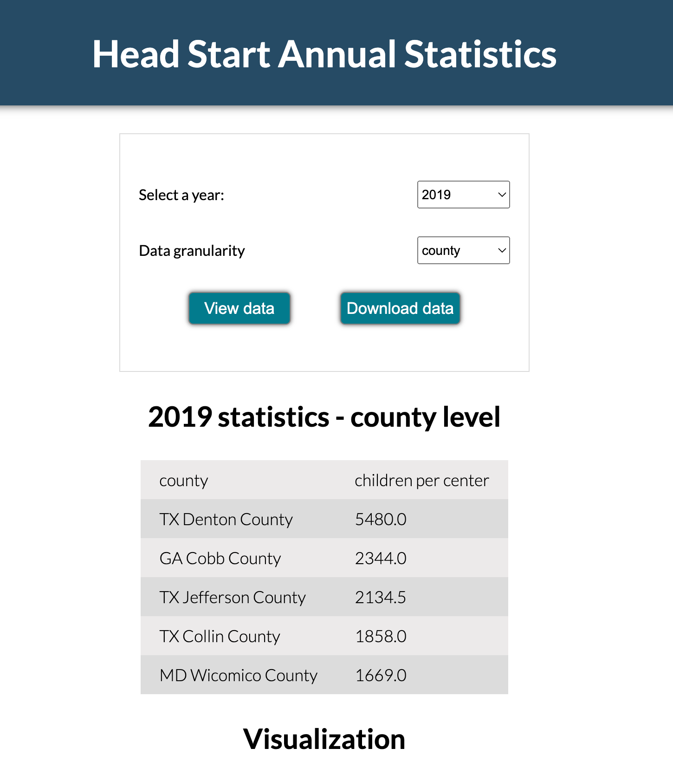
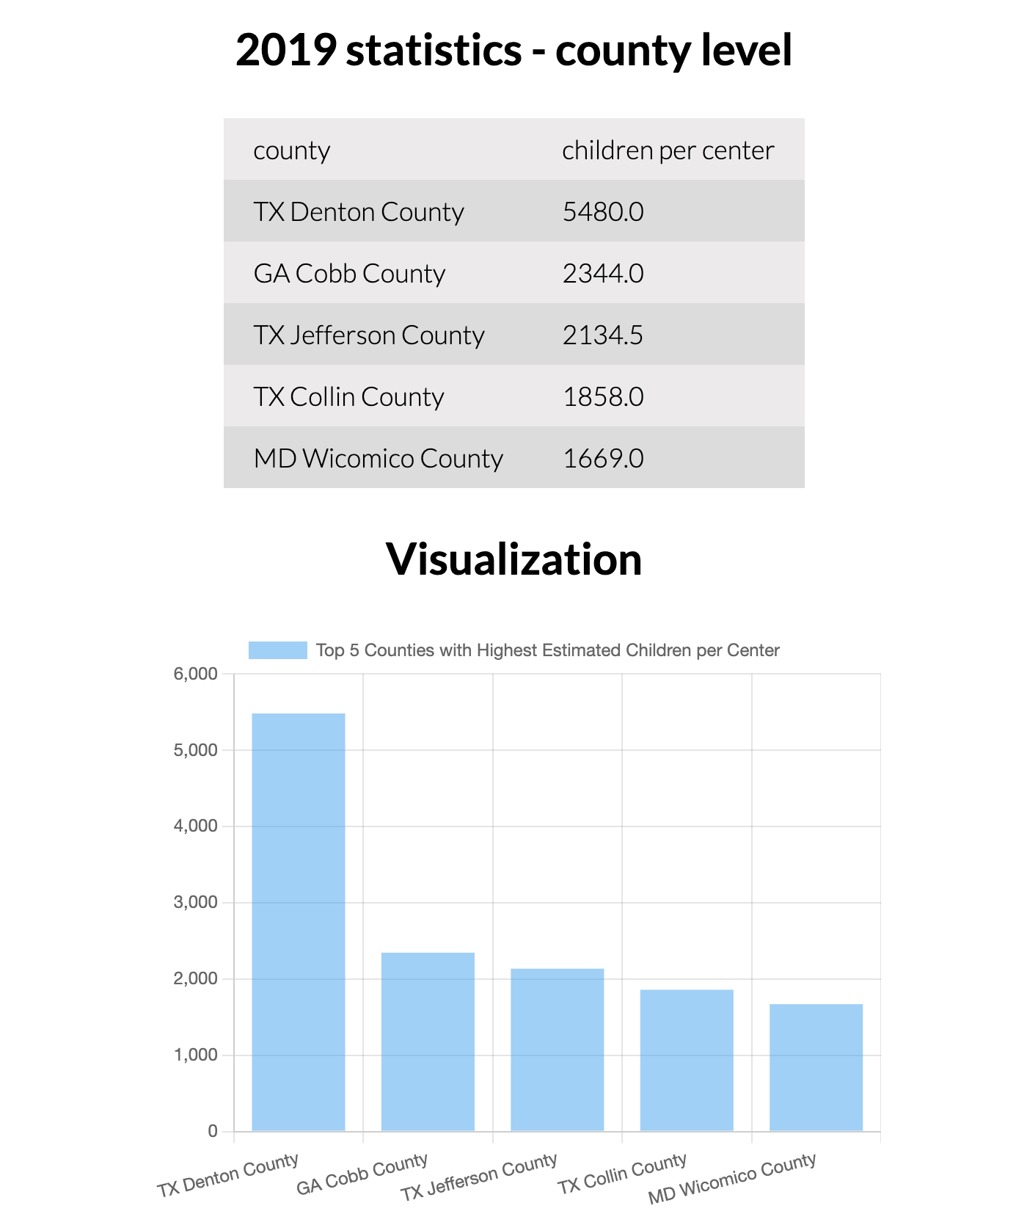
Automated Analytics Pipeline -
Analyze once, track forever
http://chaconn3.me (PC access for best experience)

Slide 22
Thank You!

